Slide 1
Employee Salary Prediction using Machine Learning
CAPSTONE PROJECT
Presented By:
Name: GODDATI HIMA NAGA GANGOTHRI
AICTE ID: STU66814ff69dd251719750646
COLLEGE: NRI INSTITUTE OF TECHNOLOGY
DEPARTMENT: INFORMATION TECHNOLOGY

Slide 2
OUTLINE
Problem Statement (Should not include solution)
System Development Approach (Technology Used)
Algorithm & Deployment (Step by Step Procedure)
Result
Conclusion
Future Scope(Optonal)
References

Slide 3
Problem Statement
This project aims to develop a machine learning model that predicts whether an individual earns more or less than $50,000 annually based on demographic and employment attributes. The dataset includes features such as age, education, occupation, and workclass. The objective is to preprocess the data, handle missing values, and apply classification algorithms to accurately categorize income levels. This solution can assist organizations in understanding income patterns and making data-driven HR decisions.

Slide 4
System Approach
System Requirements:
Python 3.x
JuPyter Notebook
Libraries: pandas, numpy, matplotlib, seaborn, sklearn
Libraries Used:
pandas for data manipulation
matplotlib and seaborn for visualization
sklearn for model building and evaluation

Slide 5
Algorithm & Deployment
Load and inspect data (adult.csv)
Handle missing values: Replaced '?' with 'Others'
Drop unwanted records: Removed rows with workclass = 'Without-pay' and 'Never-worked'
Encode categorical variables using Label Encoding
Split dataset into training and testing sets
Train models: Logistic Regression, Decision Tree, Random Forest
Evaluate using accuracy, confusion matrix
Deploy : Could be hosted via Streamlit if needed

Slide 6
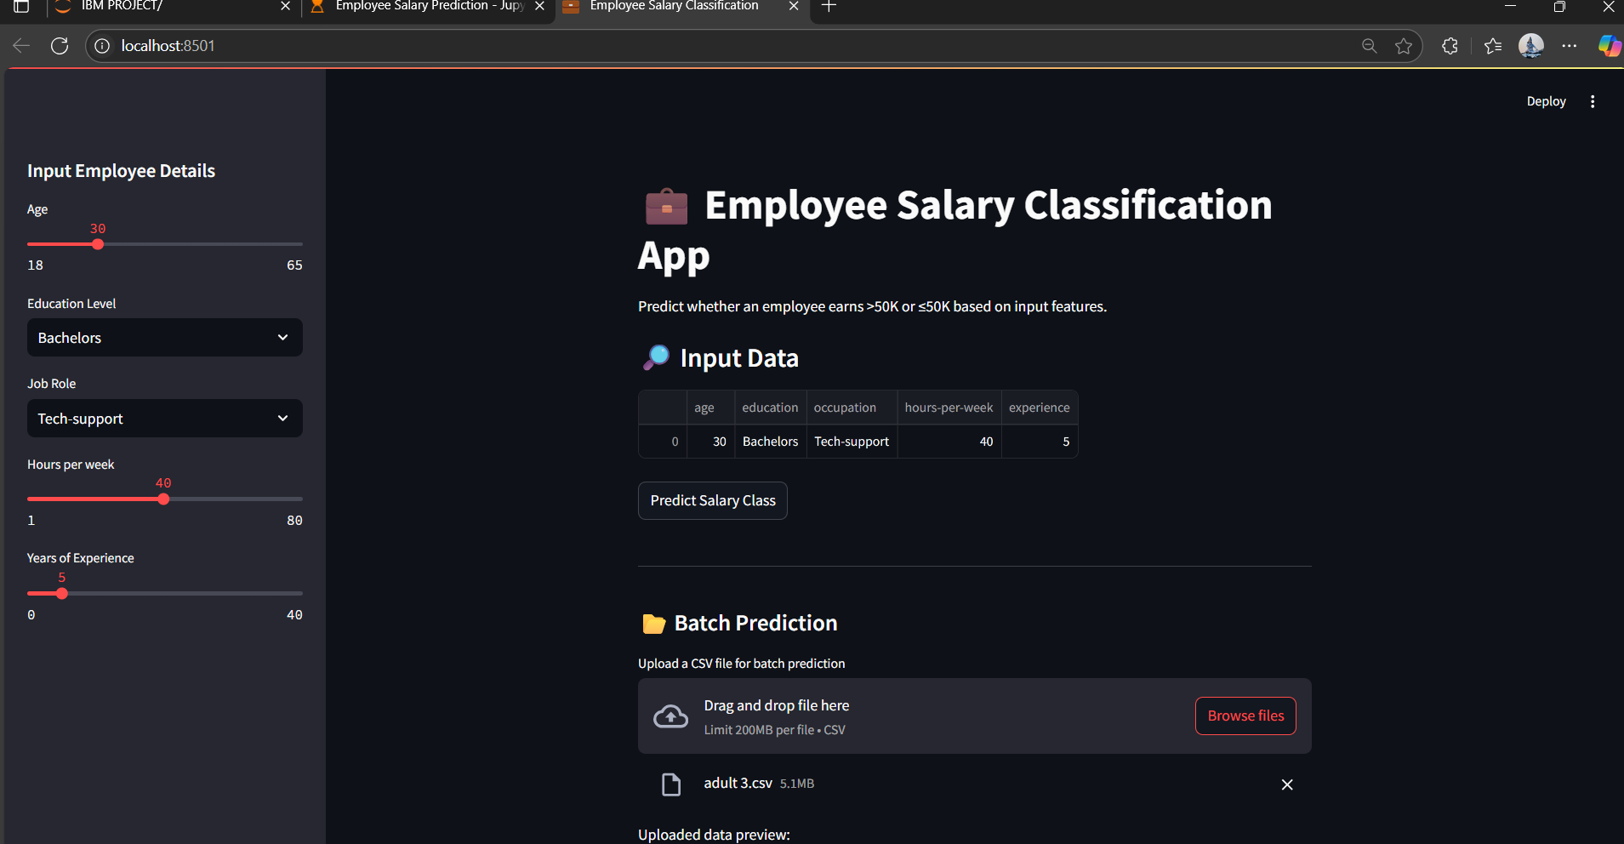

Slide 7
Result
GITHUB: https://github.com/Gangothri-1221/Employee-Salary-Prediction-Using-Machine-Learning

Slide 8
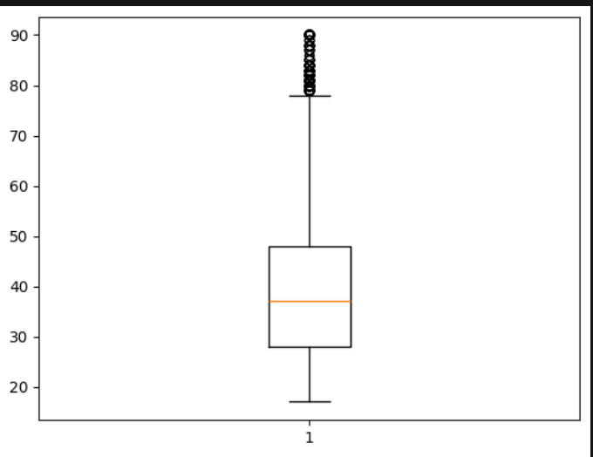

Slide 9
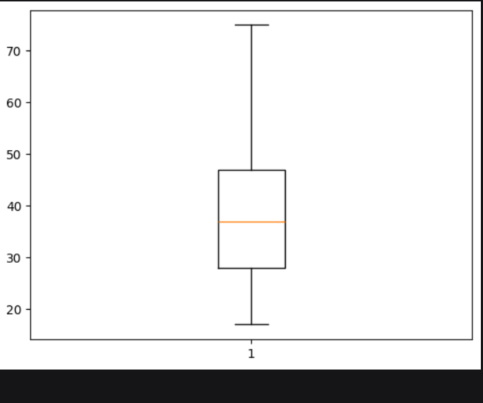

Slide 10
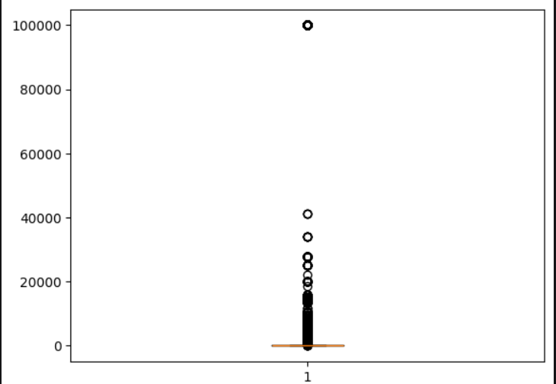

Slide 11
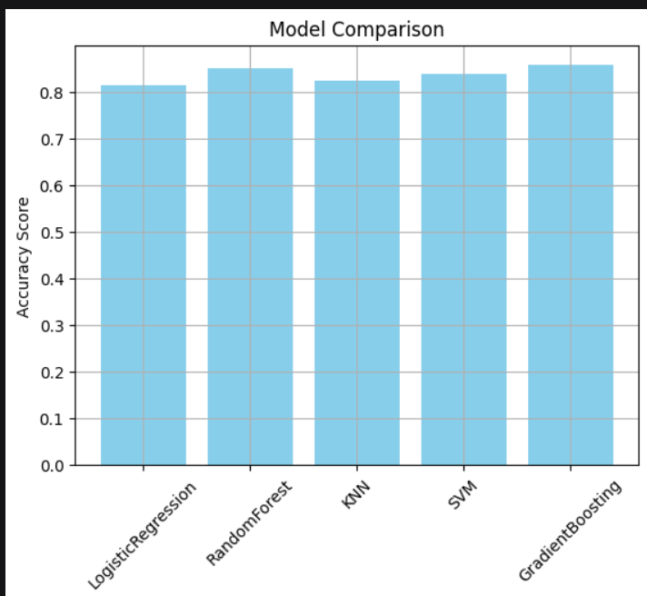

Slide 12
Conclusion
The project effectively predicted salary classes using demographic data. Random Forest classifier provided the best accuracy and generalization. Preprocessing steps significantly impacted the model's performance. Handled categorical data, missing values, and evaluated multiple models. Challenges included data cleaning and choosing optimal algorithms.

Slide 13
Future scope(Optional)
Deploy the model using Streamlit for public access
Integrate with a web-based HR tool
Include more advanced features (e.g., education field, zip code)
Implement hyperparameter tuning and deep learning models
Make it interactive with dashboards (e.g., using Power BI or Tableau)

Slide 14
References
UCI Machine Learning Repository – Adult Dataset
scikit-learn documentation
pandas, matplotlib, seaborn official docs
Medium articles and Kaggle notebooks on income classification

Slide 15
THANK YOU

